Slide 1
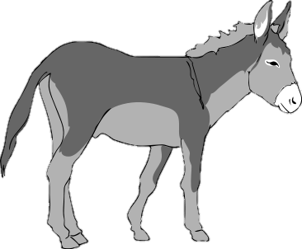
Little Donkey

Slide 2
Little donkey, little donkey on the dusty road,
Got to keep on plodding onwards with your precious load.
Been a long time, little donkey, through the winters night,
Don't give up now, little donkey,
Bethlehem's in sight.

