Slide 1
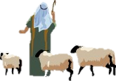
Shepherd’s Watched

Slide 2
Shepherds watched their lambs and sheep,
Through the night so dark and deep.
See, the angel in the skies,
Asking them to stand and rise.
Hidom, hidom, hi-dom-dom,
Hidom, hidom, hi-dom-dom,
Hidom, hidom, hi-dom-dom,
Hidom, hidom, hi-dom-dom.

