Slide 1
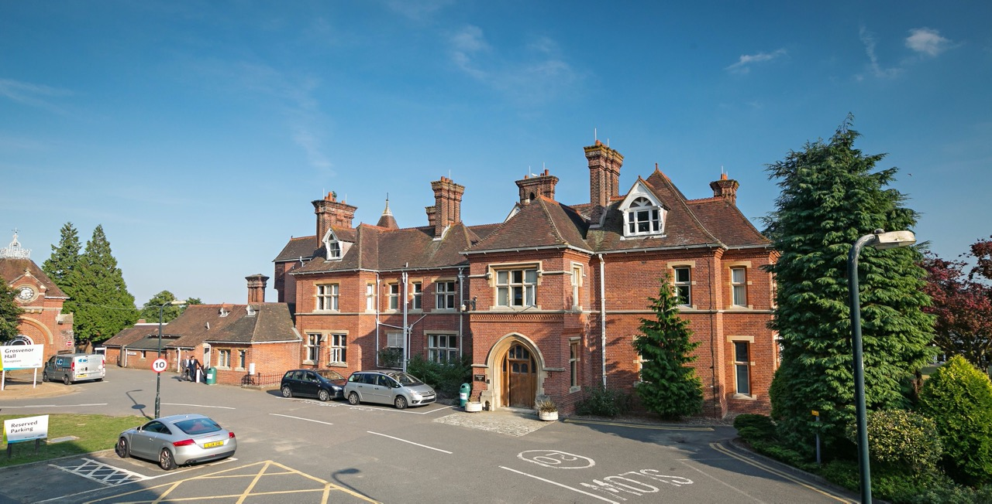
PGL
Welcome to
Grosvenor Hall
Kennington, Ashford, TN25 4AJ

Slide 2
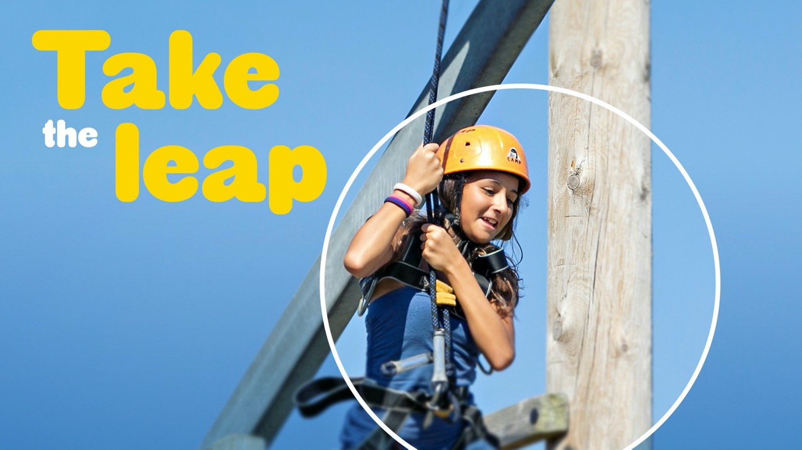
An educational adventure to remember…
Location: Grosvenor Hall, Kent
Date:8th June 2026

Slide 3
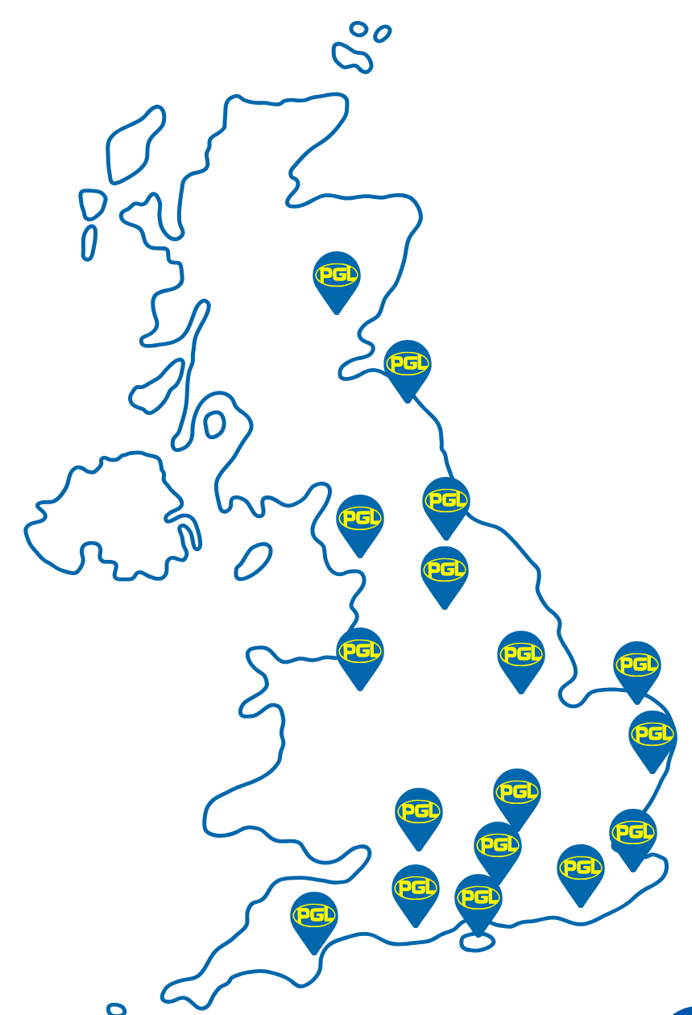
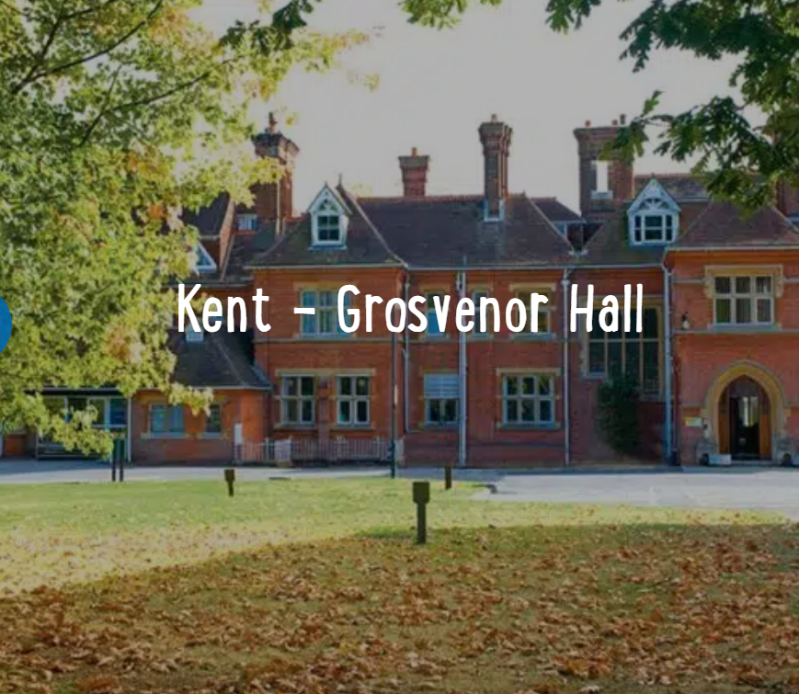
Adults going to PGL - Mrs Glover - Miss Edwards - Mrs Pattrick - Mr Doye - Mrs Radford - Mr Hawkins - Miss Payne

Slide 4
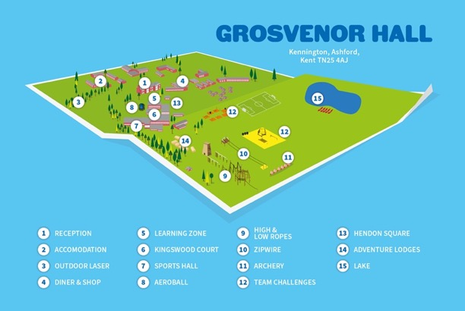
Your centre
A complete indoor and outdoor education facility set in the grounds of a former manor house in Ashford, Kent. One of our largest centres, Grosvenor Hall has 50 acres of adventure and recreational facilities.
From the moment you enter the gates, you are immersed in the high-adrenaline excitement of the centre as you pass the adventure park and our lake that offers a high range of water activities such as canoeing and raft building! As you explore the centre our guests continue to discover everything Grosvenor Hall has to offer including a 25,000 sq. ft sports hall which caters for a wide range of indoor activities.

Slide 5


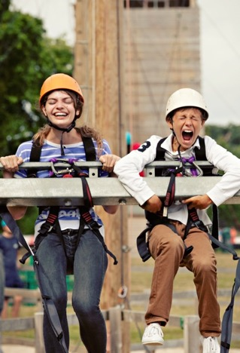
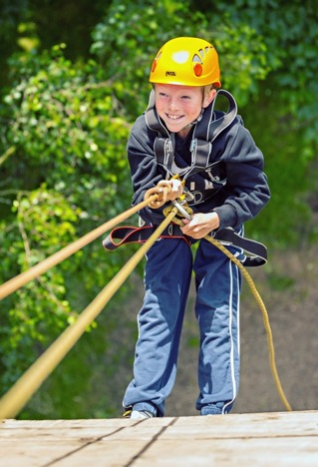
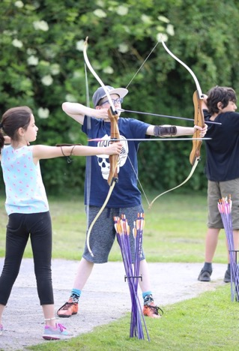
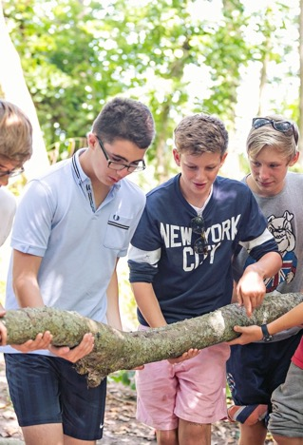
Highlights of
Grosvenor Hall

Slide 6



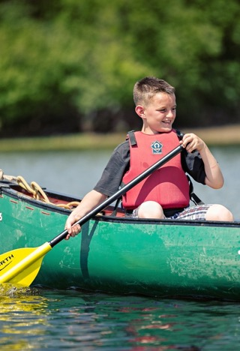
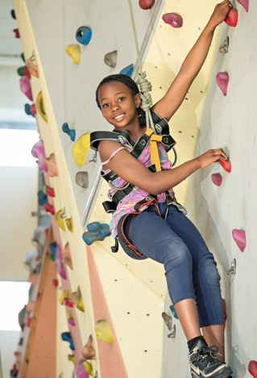
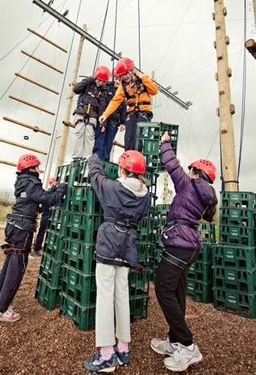
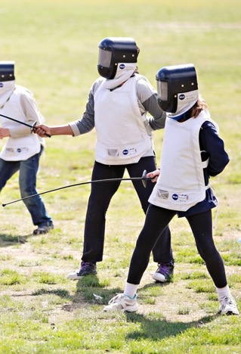
Highlights of
Grosvenor Hall

Slide 7



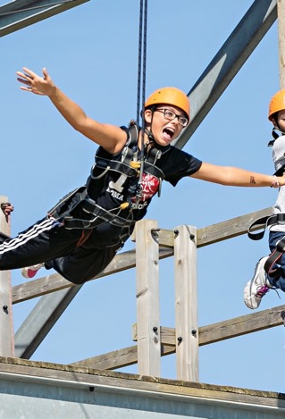
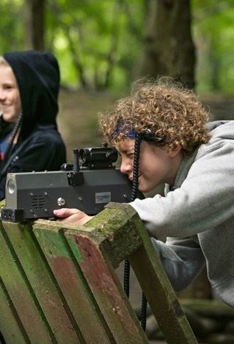
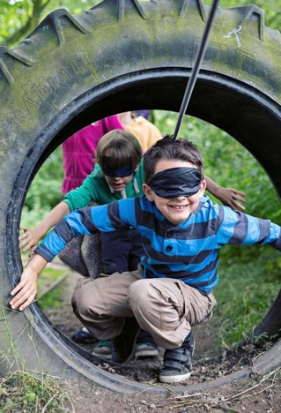
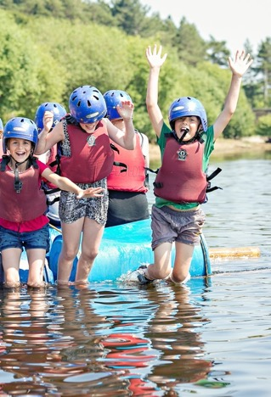
Highlights of
Grosvenor Hall

Slide 8
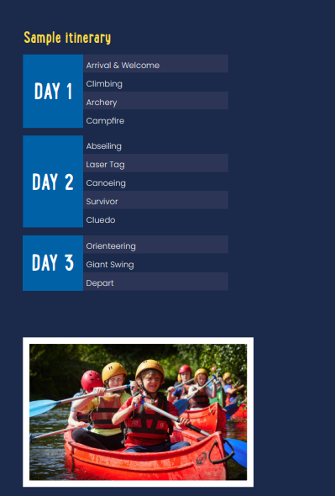

Slide 9
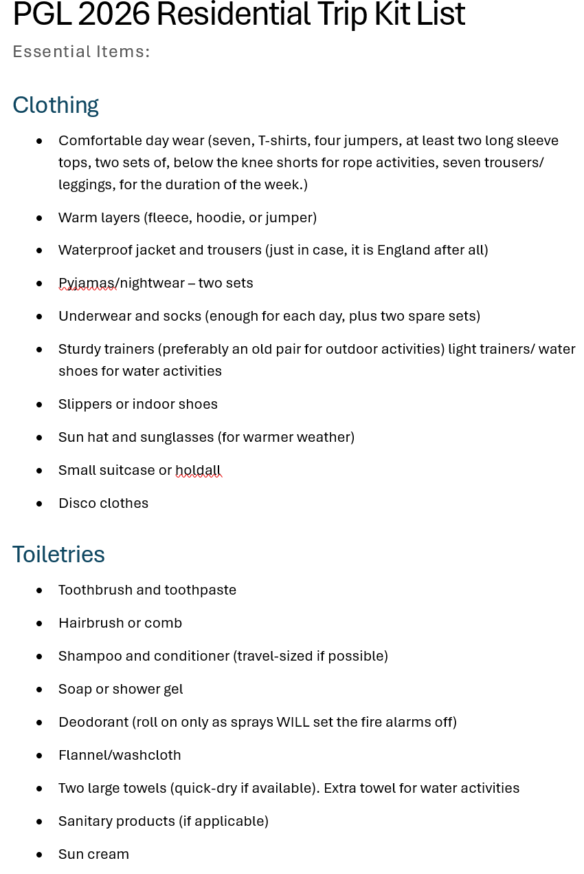
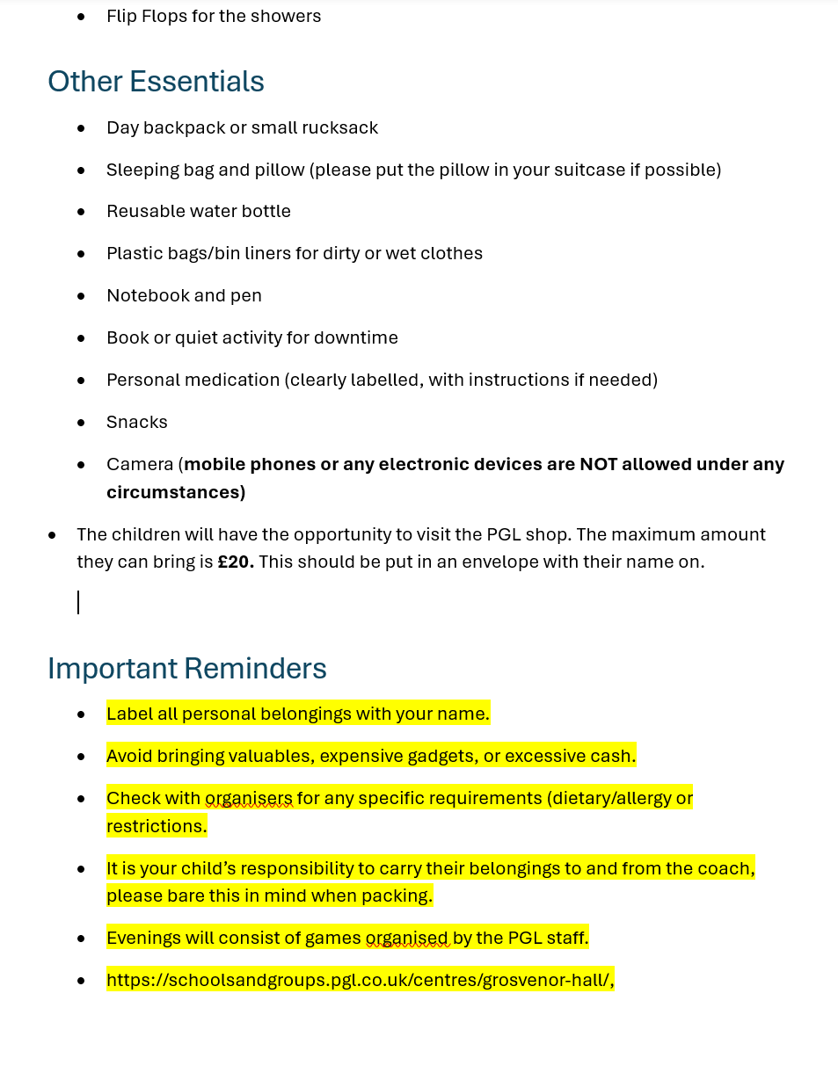
*Please note that most activities require long sleeves.

Slide 10
Packing list continued
They can bring some money with them (no more than £20) in case they would like to make a purchase in the centre shop. The shops sell snacks and drinks, as well as postcards, souvenirs, games and mementos.
Please do not bring: Mobile phones, expensive cameras, electronic games, expensive or cherished jewellery, expensive or favourite clothing or shoes. We (and PGL) can’t accept liability for the loss, theft or damage of any personal property your child may bring.

Slide 11
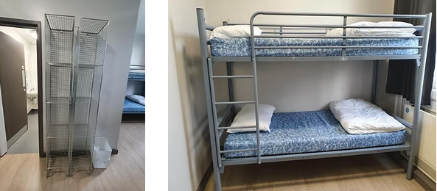
A bit more about your centre…
Sleeping
Grosvenor Hall has standard dormitory style accommodation. Rooms range from twins to 8 bed dormitories, with gender-separated bathroom and shower facilities and party leader rooms close by.
Children have a small space to store their belongings.
They will need to put their sleeping bag and pillow on their bed when they arrive!

Slide 12
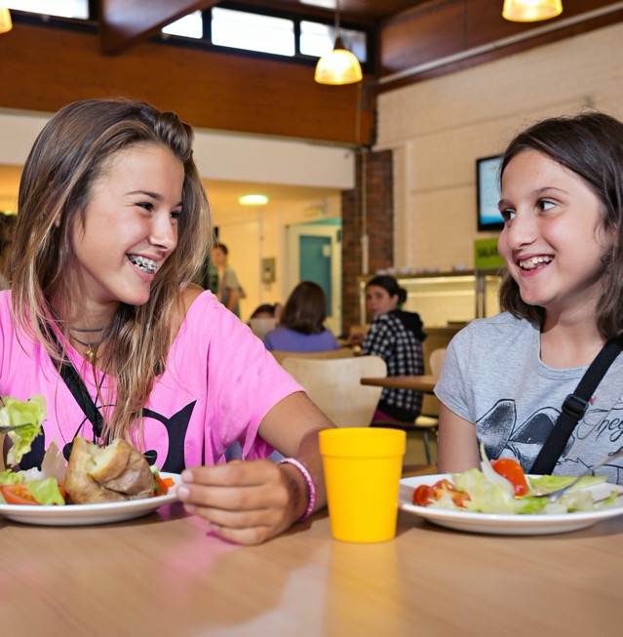
A bit more about your centre…
Eating
To fuel young guests during a long day of thrilling adventure activities, we serve three meals per day, with lots of choice and seasonal variations.
Each day there is a carefully balanced and nutritional meal plan.
We are aware of the children’s allergies and have made PGL aware, so they can cater accordingly.

Slide 13

Sample Menu

Slide 14
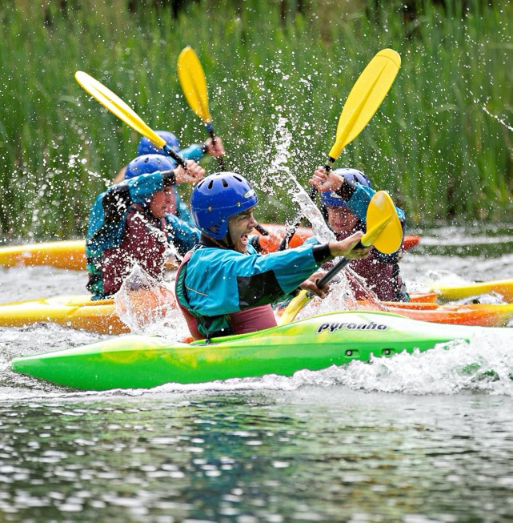
Discover more
Visit their website at
https://schoolsandgroups.pgl.co.uk/centres/grosvenor-hall/#programmes
https://schoolsandgroups.pgl.co.uk/centres/grosvenor-hall/

Slide 15

Thank you!
Any questions?

